Slide 1
ROUTING ALLPARTS
Emp no : V3200078
Emp Name : Lương Việt Hoàng

Slide 2
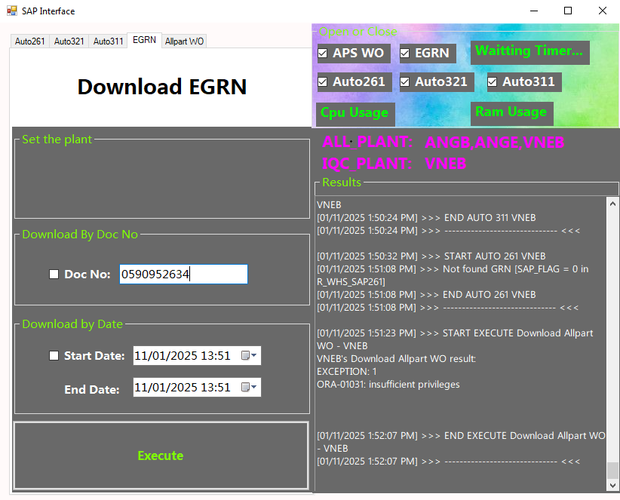
1. DOWNLOAD EGRN
The fisrt, SAP Interface will download Doc no from SAP to Allpart system.

Slide 3
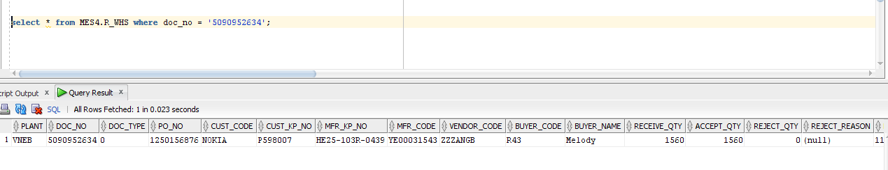
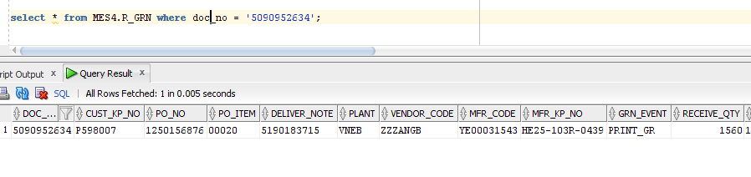
1. DOWNLOAD EGRN
After download, data will be insert to table MES4.R_WHS and MES4.R_GRN

Slide 4
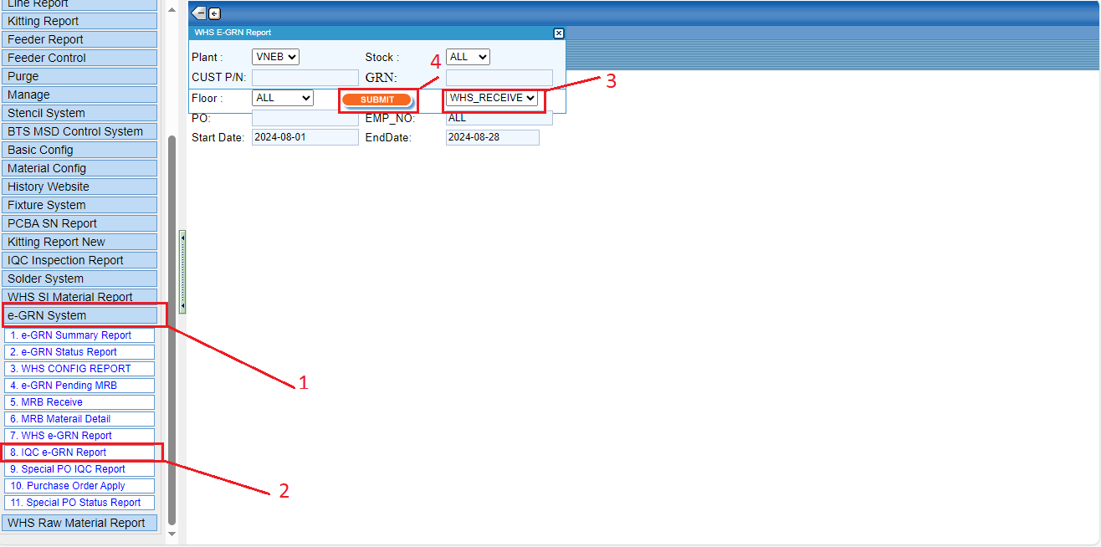
2. WHS RECEIVE MATERIAL
WHS will go to allparts web to get materials.

Slide 5
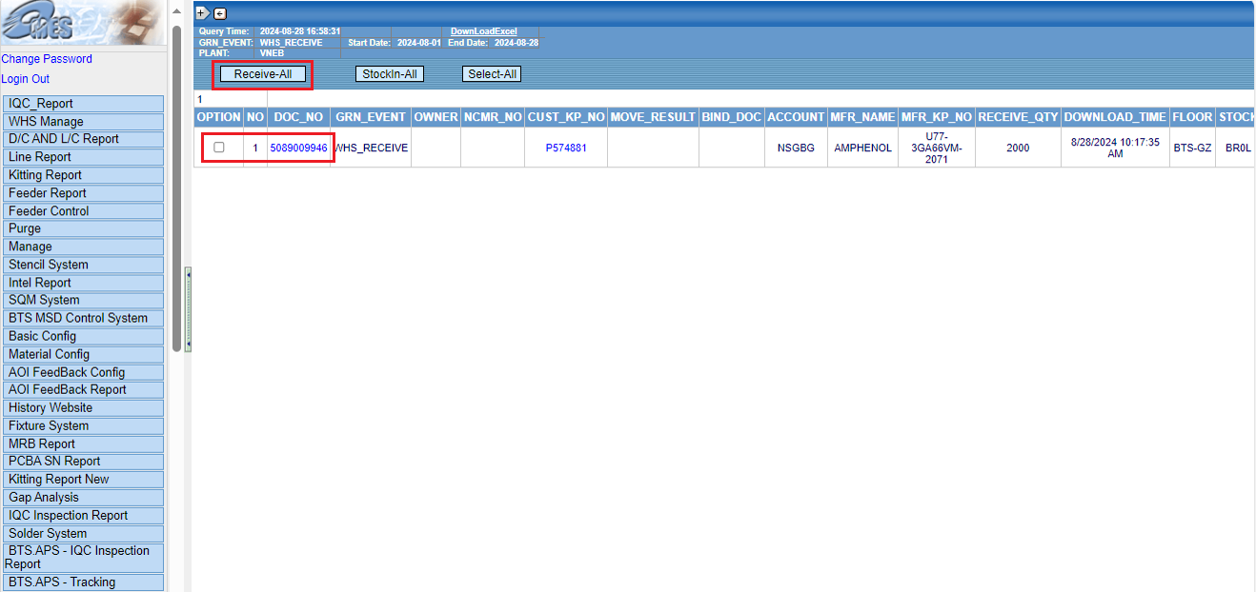
2. WHS RECEIVE MATERIAL
WHS go to web allparts to receive material.

Slide 6

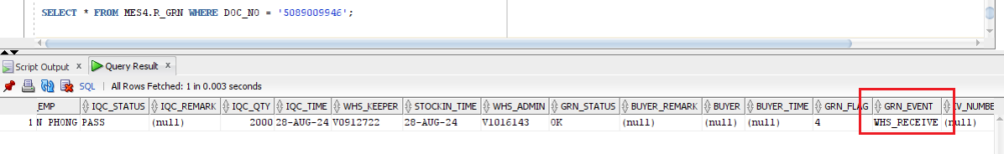
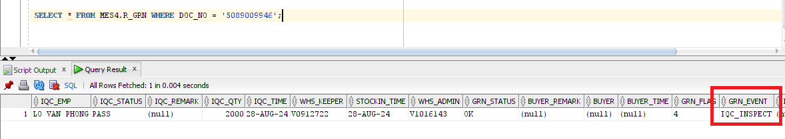
2. WHS RECEIVE MATERIAL
After download, the data in column GRN_EVENT of the table MES4.R_GRN will be updated
After

Slide 7
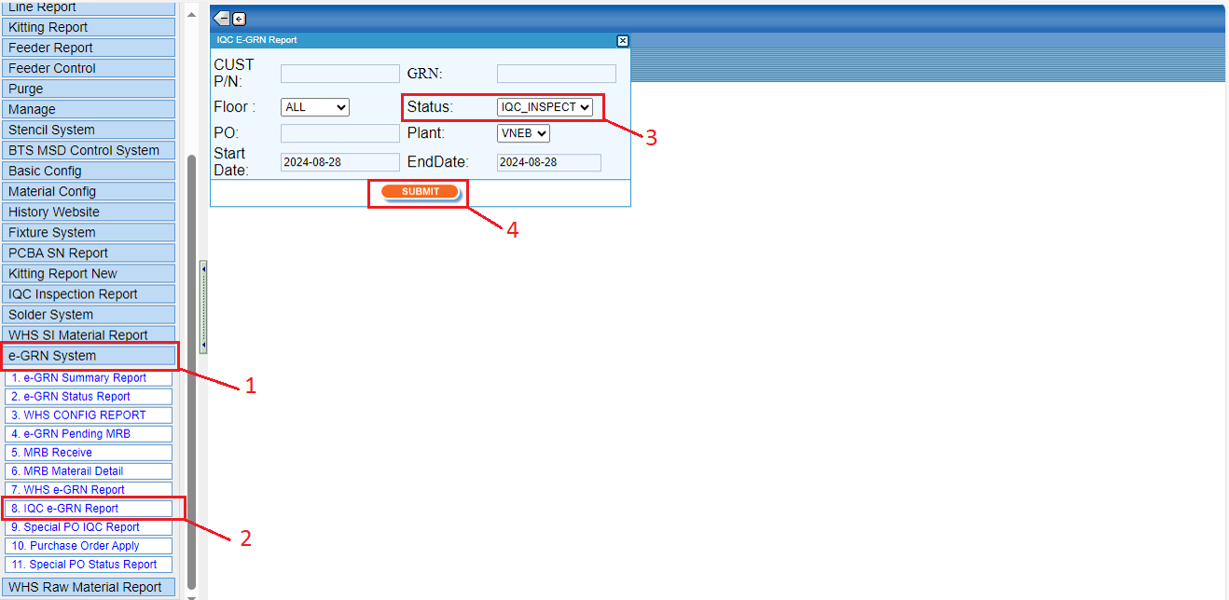
3. IQC INSPECTION
IQC will go to web to check material need inspection

Slide 8
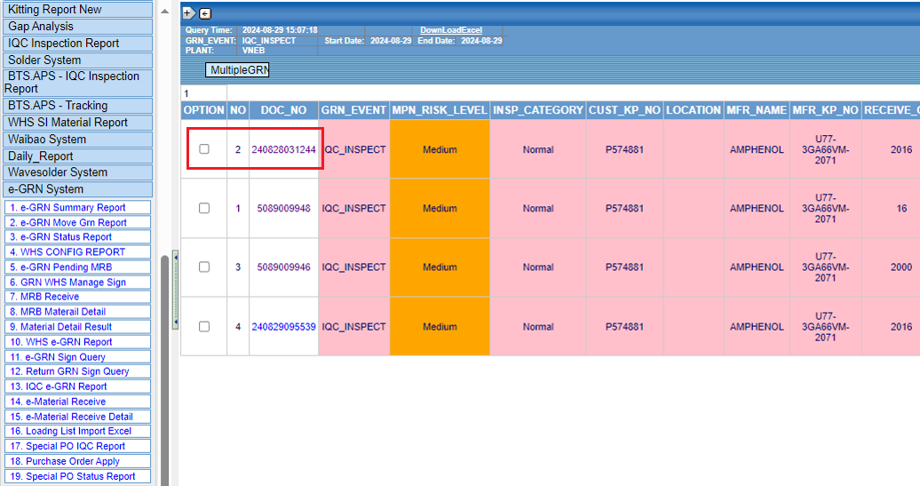
3. IQC INSPECTION
After WHS receive material, IQC will go to web allpart inspect material

Slide 9
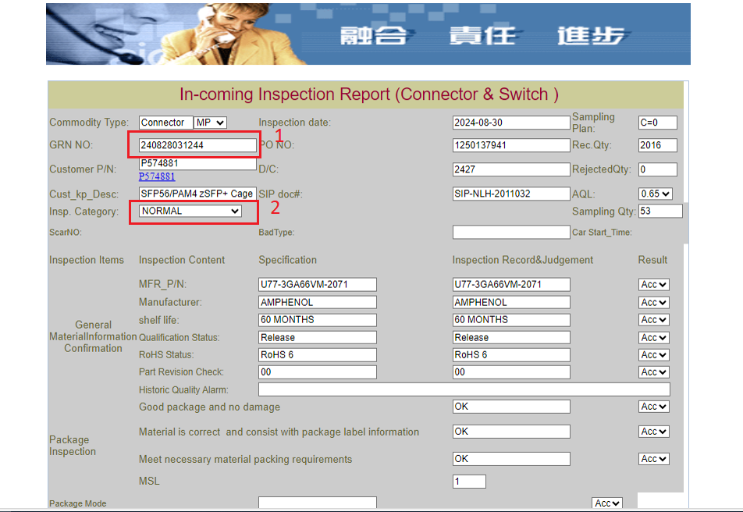
3. IQC INSPECTION
IQC will check the material and fill in the material information in the form on the web

Slide 10
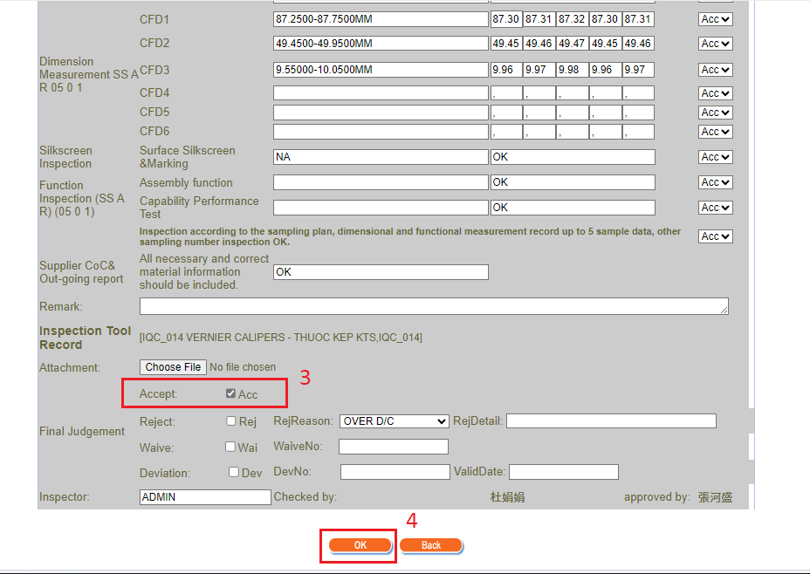
3. IQC INSPECTION
IQC will check the material and fill in the material information in the form on the web

Slide 11
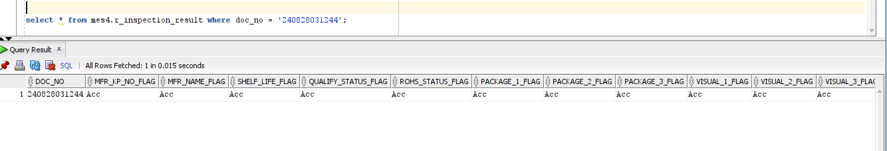
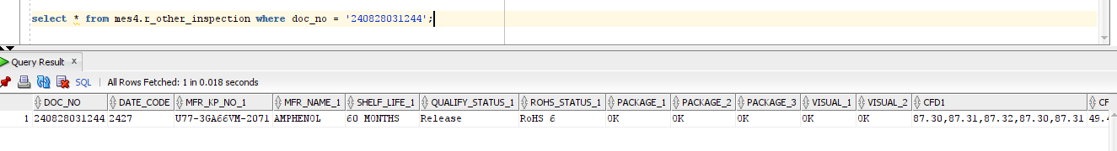
3. IQC INSPECTION
After IQC checked. data will be inserted into 2 tables:
MES4.R_INSPECTION_RESULT
MES4.R_OTHER_INSPECTION

Slide 12
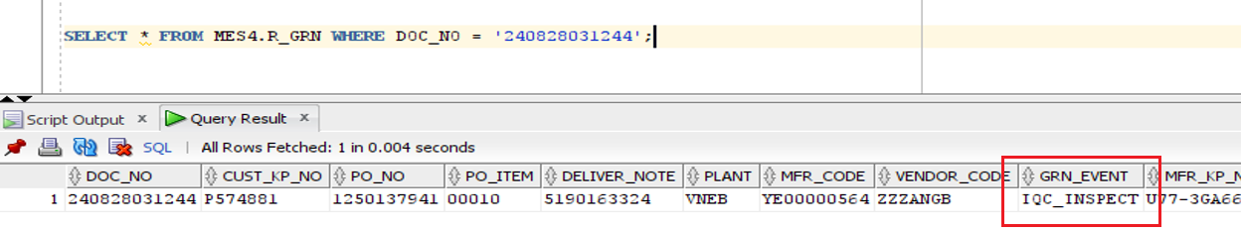

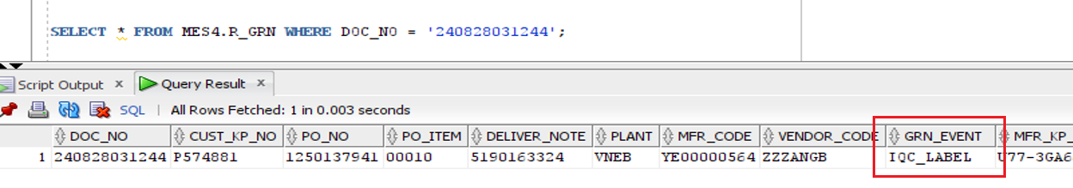
3. IQC INSPECTION
The data in column GRN_EVENT of table MES4.R_GRN will be updated

Slide 13
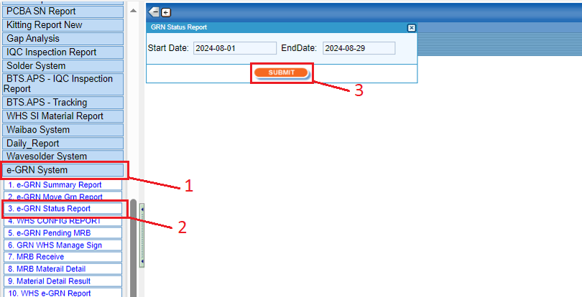
4. IQC PRINT LABEL FOR MATERIAL
IQC team will go to web to check the materials need to print label

Slide 14
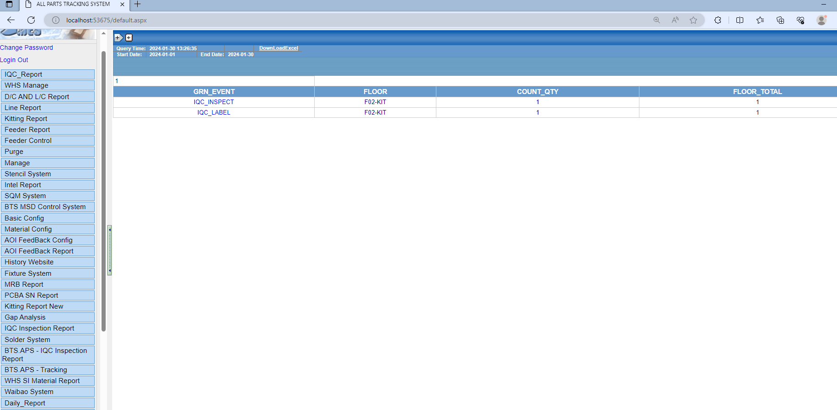
4. IQC PRINT LABEL FOR MATERIAL
IQC team will go to web to check the materials need to print label

Slide 15
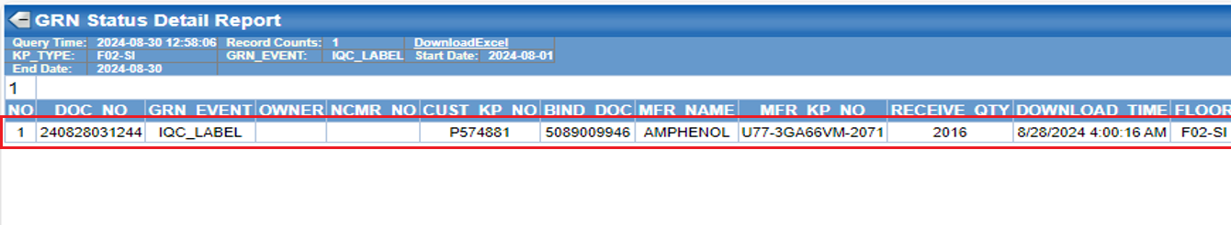
4. IQC PRINT LABEL FOR MATERIAL
IQC team will go to web to check the materials need to print label

Slide 16
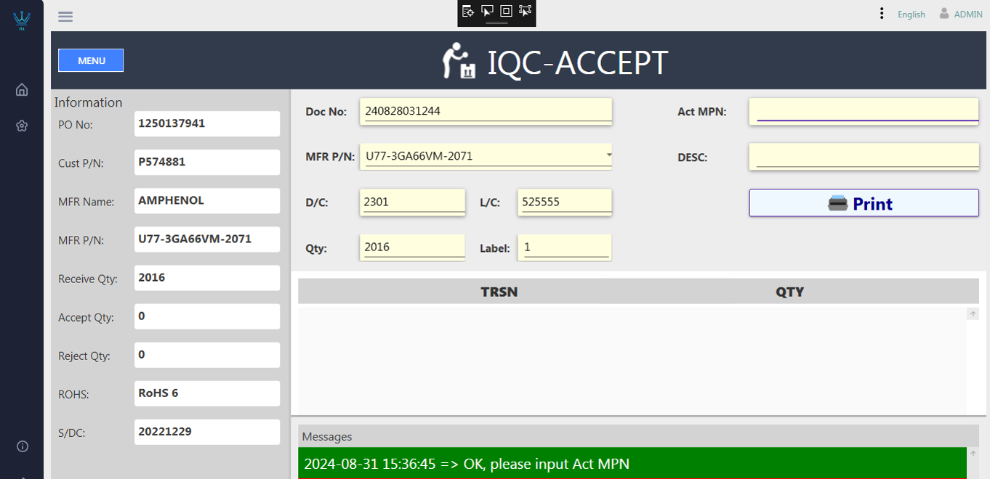
4. IQC PRINT LABEL FOR MATERIAL
IQC team use IQC-ACCEPT program to print label

Slide 17
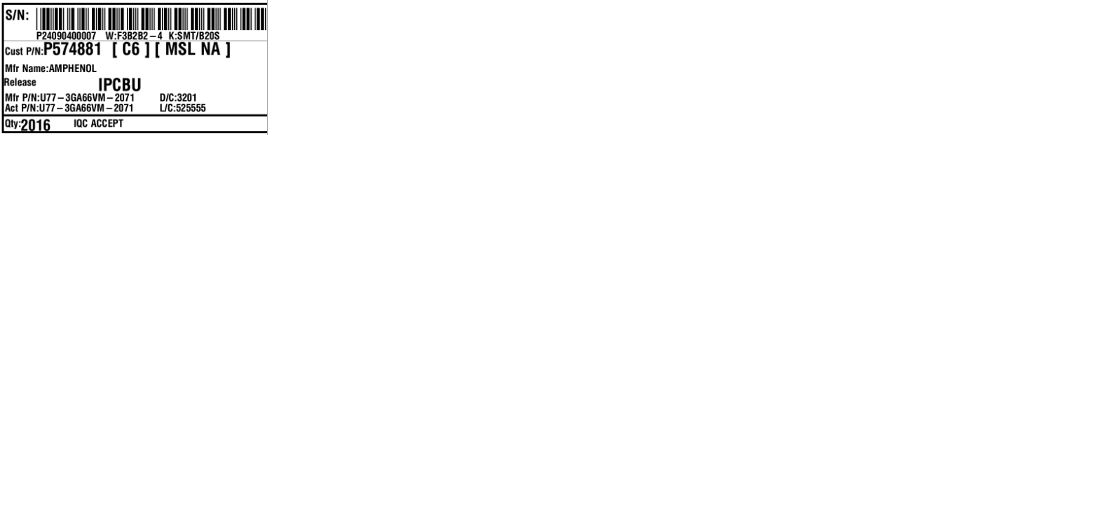
4. IQC PRINT LABEL FOR MATERIAL
IQC team use IQC-ACCEPT program to print label

Slide 18
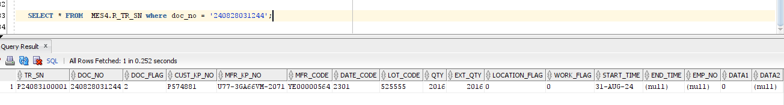
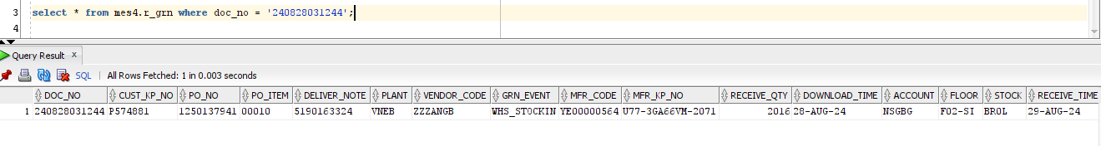
4. IQC PRINT LABEL FOR MATERIAL
After IQC team printed label for the materials. Data will insert to table MES4.R_TR_SN
And data will update in table MES4.R_GRN:

Slide 19
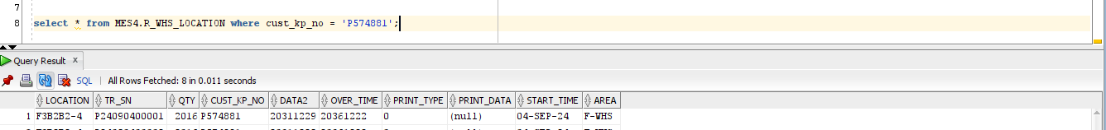
4. IQC PRINT LABEL FOR MATERIAL
And data will insert to table MES4.R_WHS_LOCATION:

Slide 20
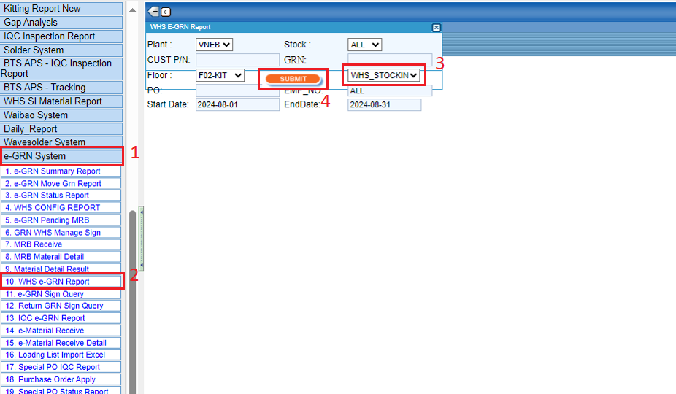
5. WHS RECEIVE MATERIAL
WHS team will go to web to receive the materials.

Slide 21
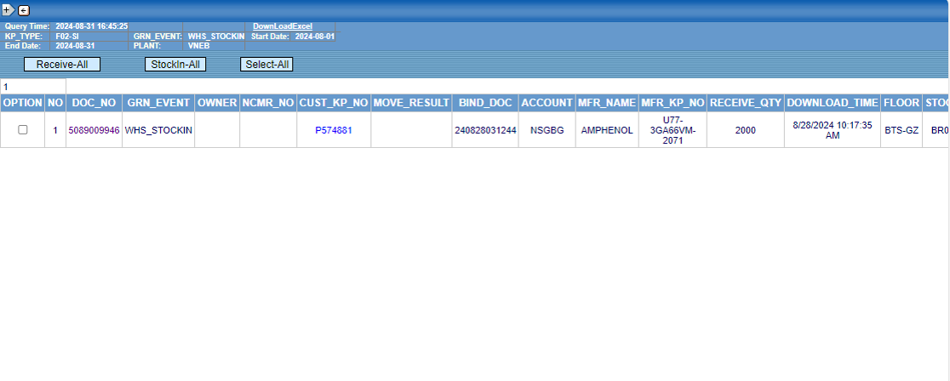
5. WHS RECEIVE MATERIAL
WHS team will go to web to receive the materials.

Slide 22
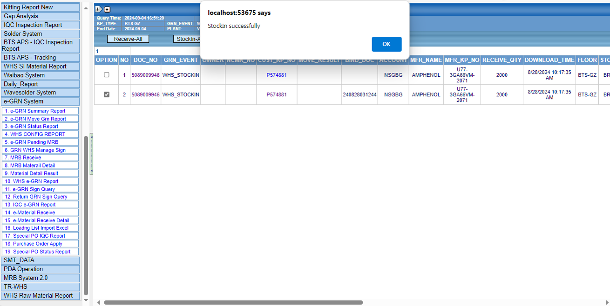
5. WHS RECEIVE MATERIAL
WHS team will go to web to receive the materials.

Slide 23
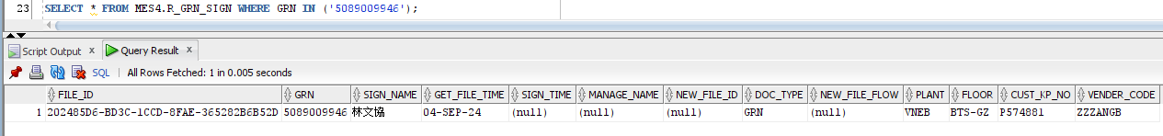
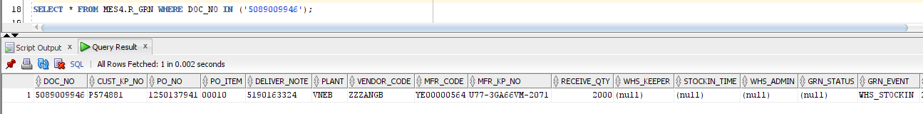
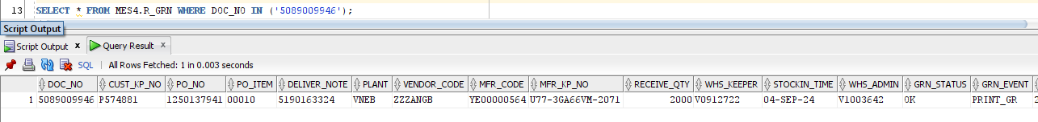
5. WHS RECEIVE MATERIAL
After WHS team received the materials. Data will insert to table MES4.R_GRN_SIGN:
And data will update in table MES4.R_GRN:

Slide 24
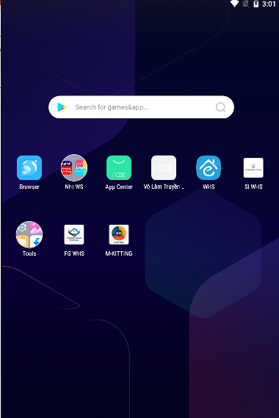
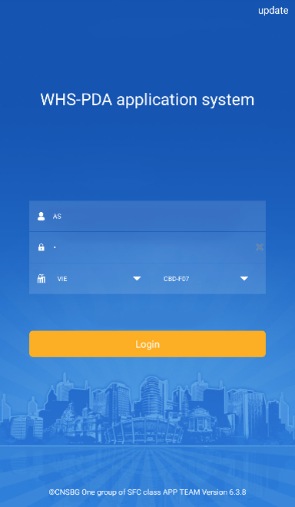
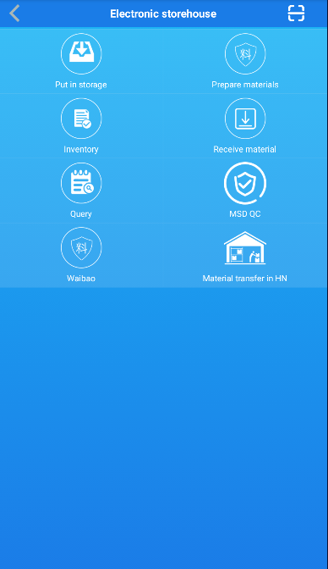
6. WHS DISTRIBUTE MATERIAL TO KITTING
WHS team use PDA / WHS application to distribute material to KITTING

Slide 25
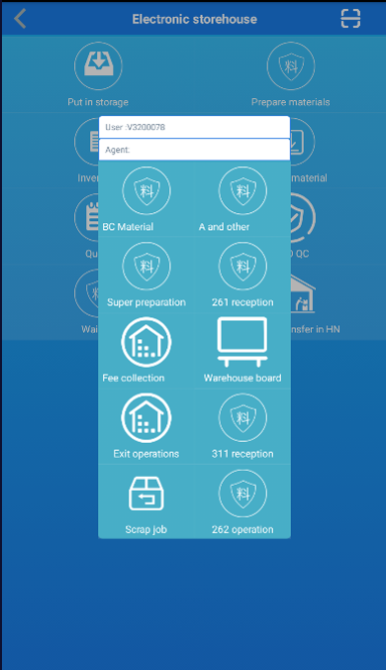
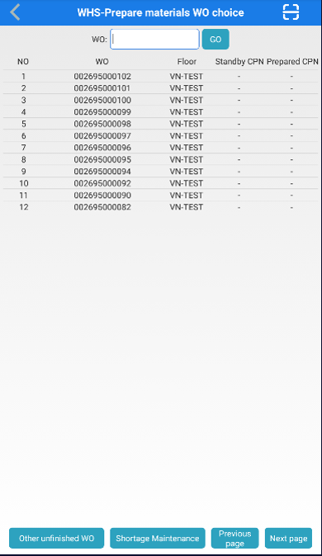
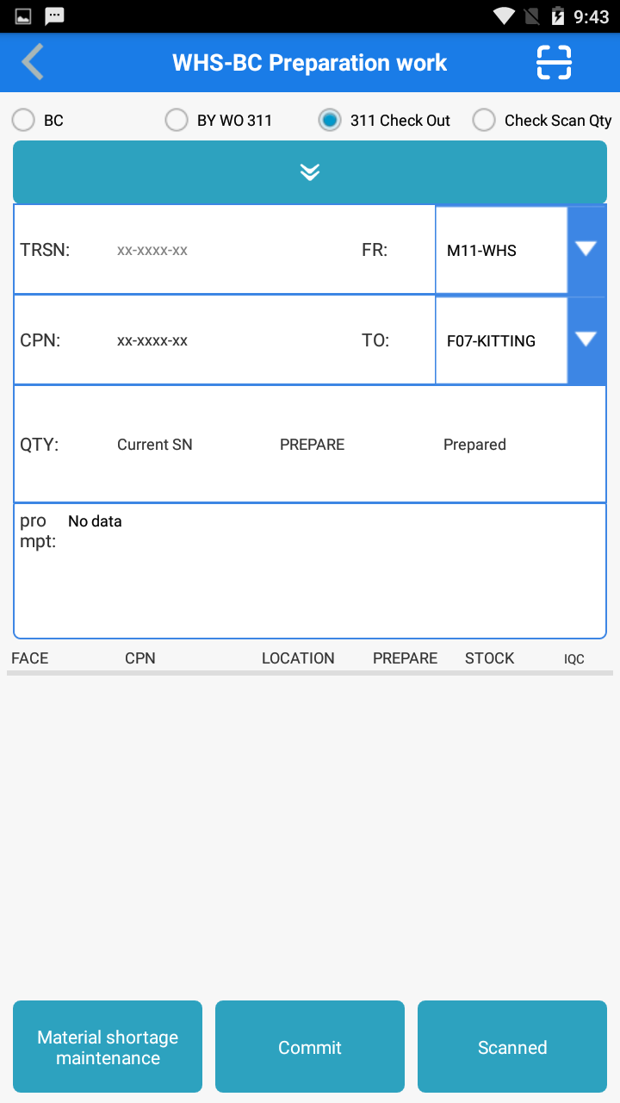
6. WHS DISTRIBUTE MATERIAL TO KITTING
WHS team use PDA / WHS application to distribute material to KITTING

Slide 26
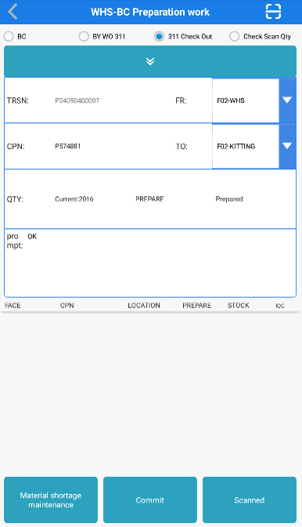
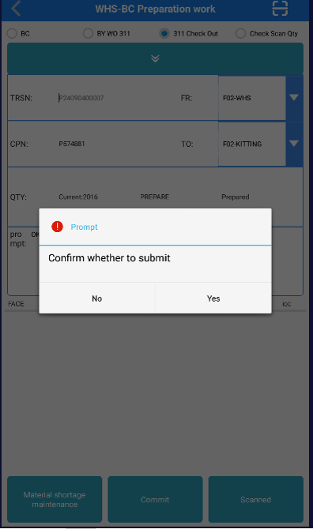
6. WHS DISTRIBUTE MATERIAL TO KITTING
WHS team use PDA / WHS application to distribute material to KITTING

Slide 27
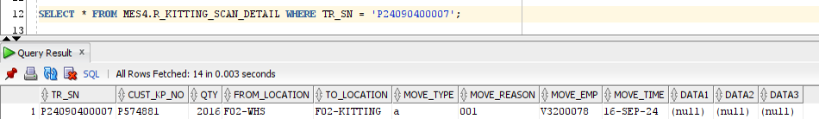
6. WHS DISTRIBUTE MATERIAL TO KITTING
After WHS team distributed the materials to KITTING. Data will insert to 2 tables:
1. MES4.R_KITTING_SCAN_DETAIL
2. MES4.R_WHS_MOVE

Slide 28
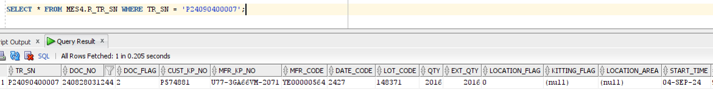
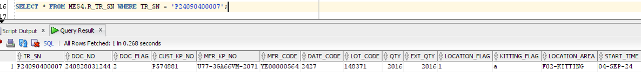
6. WHS DISTRIBUTE MATERIAL TO KITTING
And data will update in table MES4.R_TR_SN

Slide 29
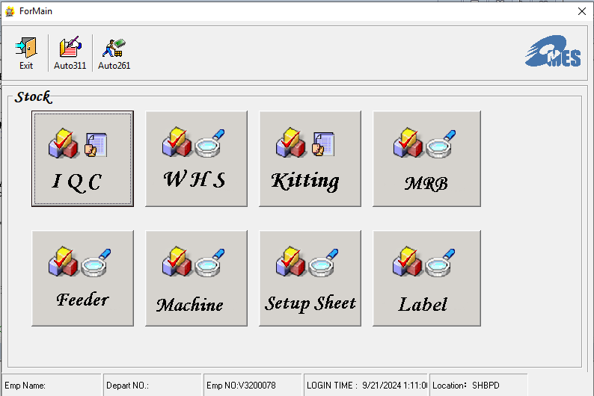
7. ME PRINT MATERIAL LIST FOR MACHINE
Using Setup Sheet program to check list material

Slide 30
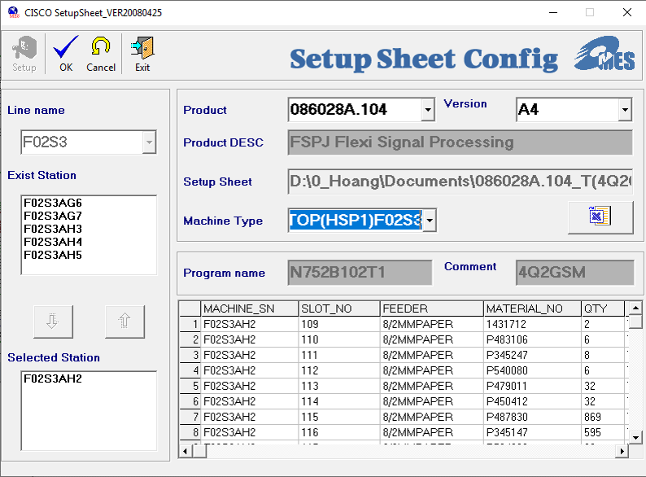
7. ME PRINT MATERIAL LIST FOR MACHINE
ME using SETUP_SHEET program to setup sheet material

Slide 31
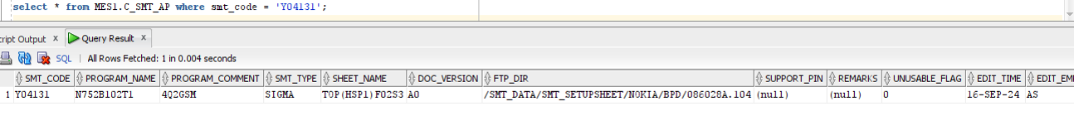
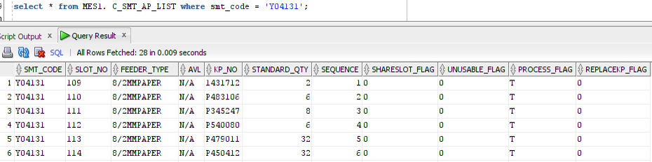
7. ME PRINT MATERIAL LIST FOR MACHINE
When Setup succees then data will insert are the table
1. MES1.C_SMT_AP
2. MES1. C_SMT_AP_LIST

Slide 32
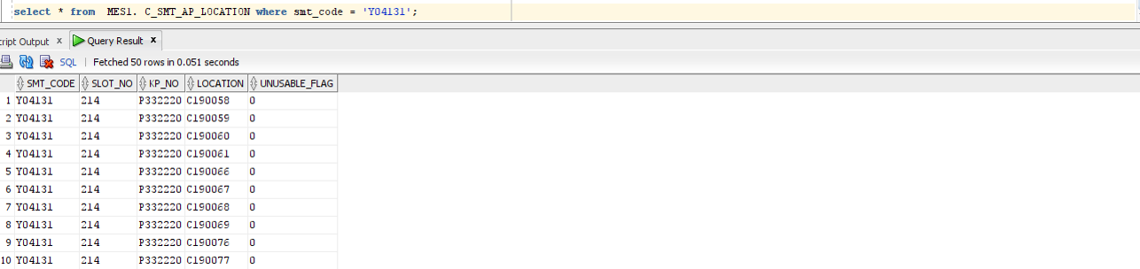
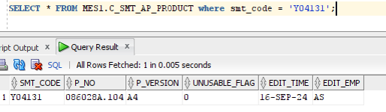
7. ME PRINT MATERIAL LIST FOR MACHINE
3. MES1. C_SMT_AP_LOCATION
4. MES1. C_SMT_AP_PRODUCT

Slide 33
7. ME PRINT MATERIAL LIST FOR MACHINE
Using MACHINE program to print list material

Slide 34
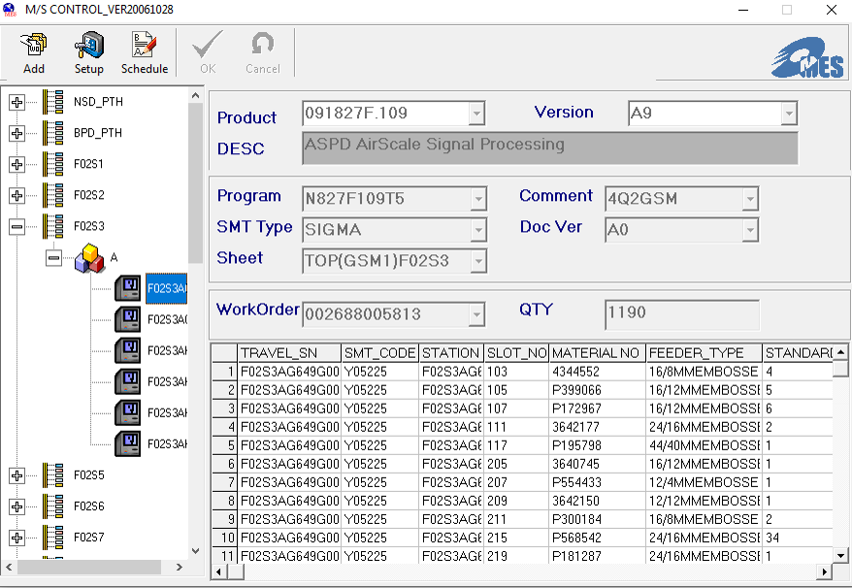
7. ME PRINT MATERIAL LIST FOR MACHINE
Using MACHINE program to print list material
2
1

Slide 35
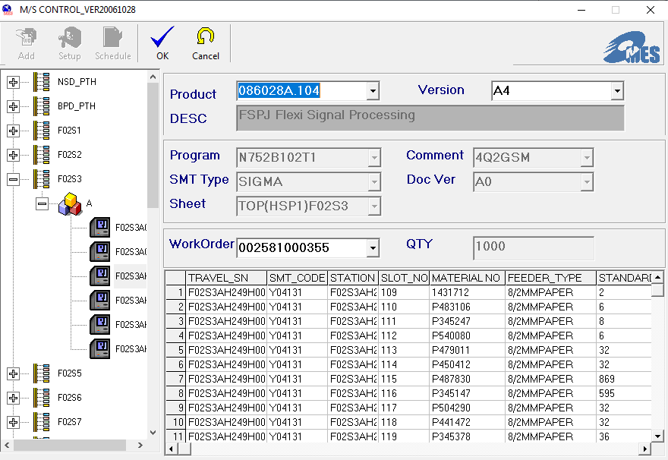
7. ME PRINT MATERIAL LIST FOR MACHINE
Using MACHINE program to print list material
Enter your Product

Slide 36
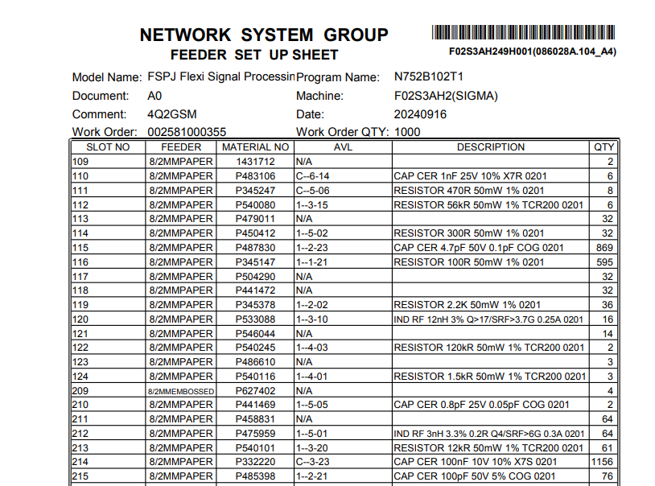
7. ME PRINT MATERIAL LIST FOR MACHINE
After successfully printing the form. The following list will be generated.

Slide 37
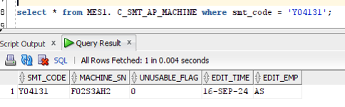
7. ME PRINT MATERIAL LIST FOR MACHINE
When Print list material succees then data will insert the table :
1. MES1. C_SMT_AP_MACHINE
2. MES4.R_TRAVEL_SN

Slide 38

8. KITTING DISTRIBUTE MATERIAL FOR LINE
Kitting prepare material for CHECK IN

Slide 39

8. KITTING DISTRIBUTE MATERIAL FOR LINE
Kitting prepare material for CHECK IN

Slide 40
8. KITTING DISTRIBUTE MATERIAL FOR LINE
Kitting prepare material for WO

Slide 41

8. KITTING DISTRIBUTE MATERIAL FOR LINE
Kitting prepare material for WO

Slide 42

8. KITTING DISTRIBUTE MATERIAL FOR LINE
Kitting prepare material for WO

Slide 43

8. KITTING DISTRIBUTE MATERIAL FOR LINE
Kitting prepare material for WO success.
1. Data in table MES4.R_TR_SN will update:
2. And data will insert into MES4.R_KITTING_SCAN_DETAIL with MOVE_TYPE = ‘a’

Slide 44
8. KITTING DISTRIBUTE MATERIAL FOR LINE
3. And data in table MES4.R_WO_REQUEST will change
DELIVER_QTY = DELIVER_QTY + TR_SN_QTY

Slide 45

8. KITTING DISTRIBUTE MATERIAL FOR LINE
Kitting using the CHECK_OUT program distribute material to give SMT

Slide 46

8. KITTING DISTRIBUTE MATERIAL FOR LINE
Kitting using the CHECK_OUT program distribute material to give SMT

Slide 47



8. KITTING DISTRIBUTE MATERIAL FOR LINE
1. After distribute material succees then data will insert the table MES4.R_TR_SN_WIP
2. And data in table MES4.R_TR_SN will update :

Slide 48


8. KITTING DISTRIBUTE MATERIAL FOR LINE
3. And data in table MES4.R_KITTING_SCAN_DETAIL will update
3. MES4.R_TR_SN_DETAIL

Slide 49
ROUTE SMTLOADING

Slide 50

OVERVIEW SMTLOADING
Kitting scan
(SFC_Terminal program)
Head of SMT line (Bot)
Scan SN check pass
(CMC)
Last SMT line (Bot)
→Scan SN check pass
(CMC)
Head of SMT line (Top)
→Scan SN check pass
(CMC)
Last SMT line (Top)
→Scan SN check pass
(CMC)
50

Slide 51

9. DOWNLOAD WO APS + SFC
Download WO&DN program will download WO:
51

Slide 52


9. DOWNLOAD WO APS + SFC
After download WO data will insert to 2 table:
1. SFB_FILE
2. MFWORKDETAIL
52

Slide 53

10. CREATE MODEL
1. PE will use the PE CONFIG function to create a new Model Information
53

Slide 54

10. CREATE MODEL
1. PE will use the PE CONFIG function to create a new Model Information
54

Slide 55

10. CREATE MODEL
1. PE will use the PE CONFIG function to create a new Model Information
55

Slide 56


10. CREATE MODEL
1. PE will use the PE CONFIG function to create a new Model Information
After create success data will insert to SFCCODELIKE table
56

Slide 57
10. CREATE MODEL
2. PE will use the PE Route Information Table function to create a new
57

Slide 58

10. CREATE MODEL
2. PE will use the PE Route Information Table function to create a new
58

Slide 59

10. CREATE MODEL
After create success data will insert to table SFCROUTEDEFB
59

Slide 60


3. PC Convert WO by PC CONFIG WO function
11. CONVERT WO

Slide 61

11. CONVERT WO
3. PC Convert WO by PC CONFIG WO function
Follow instructions

Slide 62

3. PC Convert WO by PC CONFIG WO function
11. CONVERT WO

Slide 63

3. PC Convert WO by PC CONFIG WO function
11. CONVERT WO

Slide 64

11. CONVERT WO
Data will be insert into MFWORKORDER table

Slide 65

4. Use the KITTING PRINT program to create the SN strip
12. ONLINE WO

Slide 66


12. ONLINE WO
Data will be insert into MFWORKORDERSNRANGE table
And MFPRINTRECORD table

Slide 67





SCAN SMTLOADING
UNDO
EMP NO
SCAN TR_SN
WORK ORDER
SCAN SN
67

Slide 68


SCAN SMTLOADING
After Scan SMTLOADING success data will insert to 2 table:
MFWORKSTATUS
MFSYSEVENT
68

Slide 69




SCAN PWB_INPUT1
UNDO
EMP NO
SCAN SN
WORK ORDER
69
69

Slide 70

SCAN PWB_INPUT1
After Scan PWB_INPUT1 success data will update MFWORKSTATUS table
70
70

Slide 71

SCAN PWB_INPUT1
And data will insert to MFSYSEVENT table
71
71

Slide 72


AUTO SCAN (BOT SIDE)
AUTO_SCAN will check material went through all the machine.
Data will insert to MES4.R_TR_PRODUCT_DETAIL table
72
72

Slide 73


SCAN AOI2
The last SMT bot side, PCB need Scan AOI2
Data will insert to MFSYSEVENT table
73

Slide 74

SCAN AOI2
And update in MFWORKSTATUS table
74

Slide 75


SCAN PWB_INPUT2
If the product must run 2 side, PCB need Scan PWB_INPUT2
UNDO
EMP NO
SCAN SN
WORK ORDER
75
75

Slide 76


SCAN PWB_INPUT2
After Scan PWB_INPUT2 success data will update in MFWORKSTATUS
76

Slide 77

PWB_INPUT2
And data will insert to MFSYSEVENT table
77

Slide 78

AUTO SCAN (TOP SIDE)
After PWB_INPUT2 need Scan AUTO_SCAN again, data will insert to table
MES4.R_TR_PRODUCT_DETAIL
78

Slide 79


SCAN AOI4
After PWB_INPUT2, next step is Scan AOI4
Data will insert to MFSYSEVENT table
79

Slide 80

SCAN AOI4
After Scan AOI4 success data will update in MFWORKSTATUS table
80

Slide 81


SCAN BTS_VI
After AOI4, next step is Scan BTS_VI
Data will insert to MFSYSEVENT table
81

Slide 82

SCAN BTS_VI
After Scan BTS_VI success data will update in MFWORKSTATUS table
82

Slide 83

SCAN PFT
After BTS_VI, next step is Scan PFT
Data will insert to MFSYSEVENT table
83

Slide 84

SCAN PFT
After Scan BTS_VI success data will update in MFWORKSTATUS
84

Slide 85

SCAN SMT_TU
After BTS_VI, next step is SMT_TU
Data will insert to MFSYSEVENT table
85

Slide 86

SCAN SMT_TU
After Scan SMT_TU success data will update in MFWORKSTATUS table
86

Slide 87

SCAN BST
After SMT_TU, next step is Scan BST
Data will insert to MFSYSEVENT table
87

Slide 88

SCAN BST
After Scan BST success data will update in MFWORKSTATUS table
88

Slide 89


SCAN BST_FI
After BST, next step is BST_FI
Data will insert to MFSYSEVENT table
89

Slide 90

SCAN BST_FI
After Scan BST_FI success data will update in MFWORKSTATUS table
90

Slide 91
END
91

